Slide 1
Presentation Guidelines
Final year project 1 & 2

Slide 2
Contents
Objective and Intended Audience
General Guidelines
Presentation guide lines
The Do nots
Things to remember
FAQ’s

Slide 3

Intended Audience
The presentation is for
Students taking Final year project 1 & 2
Anyone who preparing an academic presentation.
*This presentation it self does not represent a typical academic or professional presentation. For once there is no presenter presenting it. It should have been a document but who likes reading boring long documents. ☺

Slide 4
Objectives
The presentation aims to provide
Guidelines
Recommendations and advices
Dos and Donts
You are encouraged to customize your presentation as long as you do it well, while staying within the limits.

Slide 5
General Guidelines

Slide 6
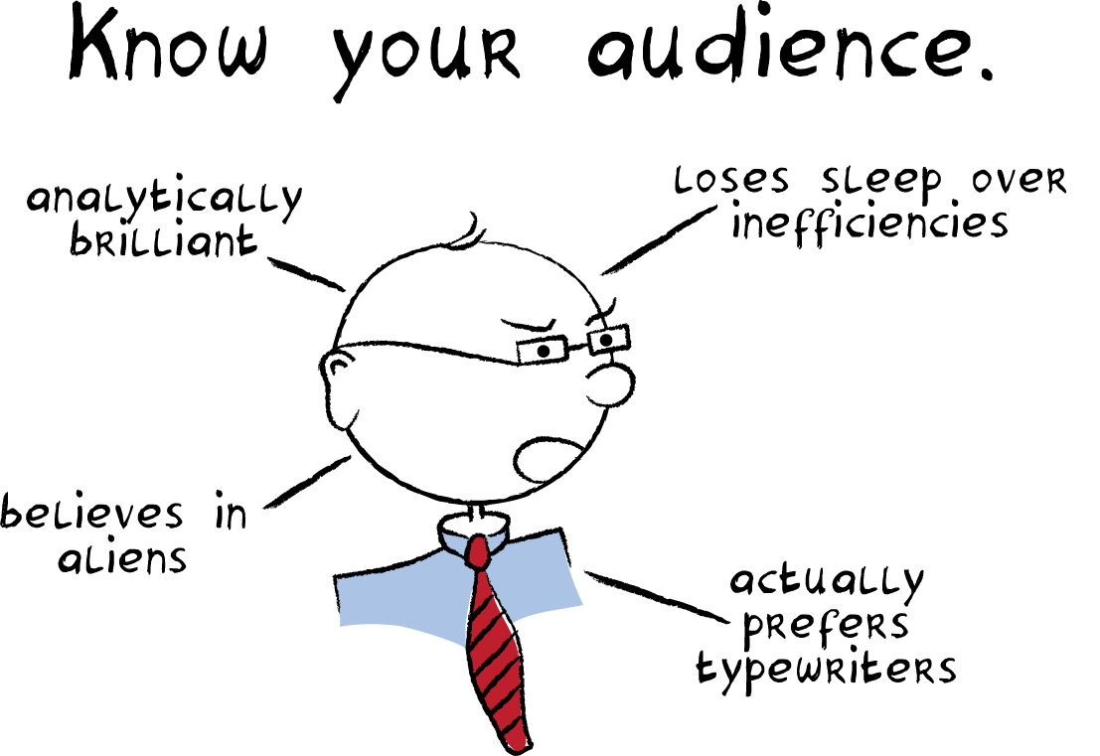
Know your audience
A common mistake made by presenters is that they don’t know their audience:
It does not mean you should have the audience’s phone number
Don’t make your own assumptions and judgments about the audience/evaluators

Slide 7
Know your audience
You can safely make following assumption though:
They are experts, professors, however, may not necessarily know about the field of your project. Think of them as intelligent but without background. Therefore, state your motivation and background clearly.
They are more experienced. Working on a project for 6 to 8 months doesn’t make you an expert. You have barely scratched the tip of the iceberg. They will know what you have done and not done.

Slide 8
The wow factor
The presentation must be self contained.
Introduce concepts when they appear for first time.
Include explanation of symbols, abbreviation and terms not common knowledge.
You are probably the most interested in your topic of project. Don’t expect others to be.
It is your task to make the topic enthralling.
“However, being satisfied is not the same thing as being delighted. If customer service is delivered in a robotic or checklist fashion, it doesn’t feel sincere. People aren’t ‘wowed’.” Sue Boche ToysRus

Slide 9
You are the Presentation
PowerPoint slides is a presentation aiding tool not the presentation. You are the presentation.
The slides are intended for the audience to organize the information being delivered to them and visualize. They are not for you. SO DON’T READ THEM.
Speak slowly with confidence and clarity. Don’t rush, mumble or speak to yourself.

Slide 10
Presentation Guidelines

Slide 11
Font and Background
Font says a lot – choose it wisely
Have high contrast between font-color and background color
Don’t choose a textured, complex picture or multi-toned high contrast backgrounds
Your text is single colored. Having high contrasts in background will make it invisible in one of the color.
Make sure your font size is big enough

Slide 12
Presentation Contents
The title page is the first slide of your presentation. It must include
Team members’ name
Supervisor’s name
Project title
University Logo
Project Logo if any
The next slide must state objective or list of objectives clearly.

Slide 13
Presentation Contents
Motivation and background
Although important but must not be the major part of the presentation
Limit 2 to 3 slides for this
Use brevity
Motivation
Why is the problem interesting
Why is it worth doing
Background
Past works others have done and existing solutions.

Slide 14
Presentation Contents
The major part of your presentation is what have you done. You may want to break this part into several headings. Below is an example
Analysis of Feasible solutions
Selected solution,
Path taken/methodologies adopted
Technologies used
Why the new solution is better
Hurdles encountered and how they were handled
Conclusion and Future recommendations

Slide 15
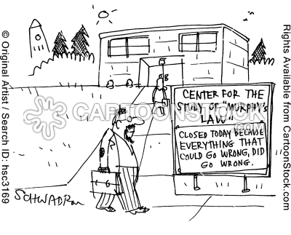
Demo
Live
Likely to get you most marks
May be victim of murphy’s law
Recorded
Record your demo
Safer than live demo. (Murphy law may still give codec not supported error.)
Hybrid
Prepare for live demo keep recorded as backup

Slide 16
Conclusion
Conclusion
List short comings, assumptions and ideal scenario for the solution to work.
Tell what was the learning outcome in short bullets
Try answering this in your conclusion
Why should we give this project an A?

Slide 17
Q & A
One of the important part of presentation
Keep a Q&A slide in the end and keep the presentation running.
You may need to refer to previous slides to answer questions.
Don’t argue
Try to understand the question. You can always say, “Due to my incompetence I was unable to understand your question. Can you please repeat?”
Or better try rephrasing the question in your own words and ask is this what has been asked of you.

Slide 18
Q & A
Don’t try to answer questions you don’t know the answer to.
Evaluators get annoyed when they know you are trying to out-smart them by giving something which is not what they asked.
You look more stupid doing so.
Admit that you don’t know the answer
Or admit that no one looked at this angle.

Slide 19
The Donts

Slide 20
The Donts
All the sentences up till now that have contained the words:-
Do not, Don’t, must not, should not, never
Negation of the sentences that include the words
Must, always, make sure, remember

Slide 21
The Donts
Don’t use times new roman
Don’t get in argument with the evaluators. Be humble.
Don’t be in a rush to end the presentation.
Don’t include slides which you don’t know about.
Don’t include long paragraphs.

Slide 22
Things to Remember

Slide 23
Remember
To prepare the presentation a week before.
To rehearse your presentation.
To include diagrams as per necessary don’t overdo them.
To use humor wisely or don’t use it all if you can’t be wise. “Humor is third side of the coin.”
To get the presentation up and running when your turn is about to come.
To make sure your laptop has enough juice to last the presentation.
To dress formally. (Not all suits are formal)

Slide 24
Remember
To be consistent in fonts and its size.
To avoid too much italics.
To maintain eye contact with audience
To use standard fonts for maximum portability.
To have backup online.
To restrict slides to have 4 to 9 bullets max.

Slide 25
FAQs
You ask and we will include them next time

Slide 26
End of Presentation
Thank you

